Slide 1

Real Retirement Solutions
State of Rhode Island and Providence Plantations
Notes:
0

Slide 2


Presentation team
Greg Hyland
Vice President Relationship Management
Gregg Libutti
District Manager
New England
1

Slide 3
Total Plan Assets as of 9/30/2014
State of Rhode Island 457(b) Deferred Compensation Plan – Mutual Funds
Total = $40,507,832 75%
State of Rhode Island 457(b) Deferred Compensation Plan – Annuity Funds
Total = $13,654,447 25%

Slide 4
Mutual Funds
07828 - STATE OF RHODE ISLAND AND PROVIDENCE PLANTATIONS
FUND ACTIVITY REPORT
07/01/2015 through 09/30/2015
INVESTMENT VEHICLE | BEGIN VALUE | CONTRIBS | CAP TRANS | DIVIDEND | INT EARNED | GAIN/LOSS | DISTRIB | INTL TRANS | CHGS/ADJ | END VALUE
AMCENT INF-ADJ BOND INV | $850,960.04 | $8,290.85 | $0.00 | $0.00 | $0.00 | -$9,392.07 | -$4,771.58 | -$45,786.17 | -$85.09 | $799,215.98
AMER CENT PREMIUM MM INV | $21,544.83 | $17.50 | $0.00 | $0.54 | $0.00 | $0.00 | $0.00 | $0.00 | -$2.16 | $21,560.71
AMER FUNDS EUROPAC R4 | $1,659,130.78 | $25,374.00 | $972.13 | $0.00 | $0.00 | -$165,475.84 | -$2,437.79 | -$3,506.37 | -$165.91 | $1,513,891.00
DREYFUS MIDCAP INDEX | $5,669,492.37 | $53,017.58 | $729.09 | $0.00 | $0.00 | -$489,011.70 | -$20,071.49 | -$11,687.84 | -$566.90 | $5,201,901.11
DREYFUS SM CAP STK INDX | $2,741,204.17 | $33,036.88 | $729.09 | $0.00 | $0.00 | -$256,668.28 | -$5,343.80 | -$10,195.91 | -$274.10 | $2,502,488.05
FEDERATED INSTL HI YLD BD INST | $133,414.70 | $2,003.20 | $0.00 | $2,233.08 | $0.00 | -$7,631.89 | $0.00 | $29,208.86 | -$13.33 | $159,214.62
FIXED INTEREST OPTION | $20,311,867.01 | $207,845.73 | $0.00 | $0.00 | $151,303.41 | $0.00 | -$260,256.34 | -$57,244.62 | $0.00 | $20,353,515.19
MFS MASS INVEST GR STK R3 | $2,486,175.17 | $28,200.24 | $486.07 | $0.00 | $0.00 | -$167,104.25 | -$33,078.33 | -$13,120.87 | -$248.68 | $2,301,309.35
PIMCO TOTAL RET A | $504,584.91 | $9,262.10 | $0.00 | $4,393.70 | $0.00 | -$5,385.76 | -$7.62 | -$200.00 | -$50.45 | $512,596.88
VANGUARD 500 INDEX ADM | $6,202,680.64 | $70,149.68 | $28,575.66 | $31,475.02 | $0.00 | -$439,569.68 | -$28,262.83 | -$5,457.68 | -$620.28 | $5,858,970.53
VANGUARD DIVIDEND GROWTH | $255,697.09 | $3,855.38 | $0.00 | $0.00 | $0.00 | -$9,308.65 | $0.00 | -$68,406.12 | -$25.55 | $181,812.15
VANGUARD TGT RTMT 2010 | $101,110.85 | $0.00 | $0.00 | $0.00 | $0.00 | -$2,431.31 | $0.00 | $9,877.77 | -$10.11 | $108,547.20
VANGUARD TGT RTMT 2020 | $322,779.44 | $6,322.00 | $0.00 | $0.00 | $0.00 | -$14,976.36 | $0.00 | $160,482.01 | -$32.28 | $474,574.81
VANGUARD TGT RTMT 2030 | $523,002.89 | $6,178.35 | $0.00 | $0.00 | $0.00 | -$32,007.14 | -$3,305.30 | $16,036.94 | -$52.30 | $509,853.44
VANGUARD TGT RTMT 2040 | $9,823.47 | $940.00 | $0.00 | $0.00 | $0.00 | -$149.65 | -$9,200.00 | $0.00 | -$0.98 | $1,412.84
VANGUARD TGT RTMT 2050 | $6,136.09 | $1,400.00 | $0.00 | $0.00 | $0.00 | -$566.85 | $0.00 | $0.00 | -$0.62 | $6,968.62
Plan 001 MUTUAL FUND TOTALS | $41,799,604.45 | $455,893.49 | $31,492.04 | $38,102.34 | $151,303.41 | -$1,599,679.43 | -$366,735.08 | $0.00 | -$2,148.74 | $40,507,832.48
Plan 001 ANNUITY TOTALS | $13,936,801.81 | $0.00 | $0.00 | $0.00 | $109,381.35 | -$260,682.70 | -$135,360.25 | $0.00 | $4,306.39 | $13,654,446.60
GRAND TOTAL | $55,736,406.26 | $455,893.49 | $31,492.04 | $38,102.34 | $260,684.76 | ($1,860,362.13) | ($502,095.33) | ($0.00) | $2,157.65 | $54,162,279.08

Slide 5
Annuity Funds
07828 - STATE OF RHODE ISLAND AND PROVIDENCE PLANTATIONS
FUND ACTIVITY REPORT
07/01/2015 through 09/30/2015
INVESTMENT VEHICLE | BEGIN VALUE | CONTRIBS | CAP TRANS | DIVIDEND | INT EARNED | GAIN/LOSS | DISTRIB | INTL TRANS | CHGS/ADJ | END VALUE
ASSET ALLOCATION FUND | $90,512.01 | $0.00 | $0.00 | $0.00 | $0.00 | -$4,745.07 | -$102.35 | $0.00 | $0.00 | $85,664.59
CAPITAL CONSERVATION | $7,727.23 | $0.00 | $0.00 | $0.00 | $0.00 | $59.11 | $0.00 | $0.00 | $0.00 | $7,786.34
CORE EQUITY FUND | $74,386.72 | $0.00 | $0.00 | $0.00 | $0.00 | -$6,333.41 | $0.00 | $0.00 | $0.00 | $68,053.31
DIVIDEND VALUE | $9,041.35 | $0.00 | $0.00 | $0.00 | $0.00 | -$547.78 | $0.00 | $0.00 | $0.00 | $8,493.57
EMERGING ECONOMIES | $13,680.72 | $0.00 | $0.00 | $0.00 | $0.00 | -$2,291.41 | -$87.73 | $0.00 | $0.00 | $11,301.58
FIXED ACCOUNT PLUS | $10,260,116.88 | $0.00 | $0.00 | $0.00 | $108,264.36 | $0.00 | -$116,548.47 | $0.00 | $4,106.55 | $10,255,939.32
FOREIGN VALUE | $3,082.74 | $0.00 | $0.00 | $0.00 | $0.00 | -$403.39 | $0.00 | $0.00 | $0.00 | $2,679.35
GLOBAL SOCIAL AWARENESS FUND | $62,250.58 | $0.00 | $0.00 | $0.00 | $0.00 | -$5,000.60 | $0.00 | $0.00 | $0.00 | $57,249.98
GOVERNMENT SECURITIES FUND | $13,736.27 | $0.00 | $0.00 | $0.00 | $0.00 | $182.70 | $0.00 | $0.00 | $0.00 | $13,918.97
GROWTH FUND | $322,972.31 | $0.00 | $0.00 | $0.00 | $0.00 | -$20,285.26 | -$5,375.47 | $0.00 | $111.71 | $297,423.29
INTERNATIONAL EQUITIES FUND | $51,494.69 | $0.00 | $0.00 | $0.00 | $0.00 | -$5,167.79 | -$89.55 | $0.00 | $0.00 | $46,237.35
LARGE CAPITAL GROWTH | $51,907.21 | $0.00 | $0.00 | $0.00 | $0.00 | -$3,547.12 | $0.00 | $0.00 | $0.00 | $48,360.09
MID CAP INDEX FUND | $894,742.68 | $0.00 | $0.00 | $0.00 | $0.00 | -$78,523.66 | -$2,693.81 | $0.00 | $0.00 | $813,525.21
MID CAP STRATEGIC GWTH | $39,215.84 | $0.00 | $0.00 | $0.00 | $0.00 | -$3,846.22 | -$109.52 | $0.00 | $0.00 | $35,260.10
MONEY MARKET I FUND | $3,148.16 | $0.00 | $0.00 | $0.00 | $0.00 | -$6.53 | $0.00 | $0.00 | $0.00 | $3,141.63
SCIENCE & TECHNOLOGY FUND | $166,557.22 | $0.00 | $0.00 | $0.00 | $0.00 | -$12,802.90 | -$3,829.79 | $0.00 | $88.13 | $150,012.66
SHORT TERM FIXED ACCOUNT | $101,318.89 | $0.00 | $0.00 | $0.00 | $1,116.99 | $0.00 | $0.00 | $0.00 | $0.00 | $102,435.88
SMALL CAP INDEX FUND | $154,816.88 | $0.00 | $0.00 | $0.00 | $0.00 | -$18,809.11 | $0.00 | $0.00 | $0.00 | $136,007.77
STOCK INDEX FUND | $1,137,280.96 | $0.00 | $0.00 | $0.00 | $0.00 | -$75,922.52 | -$5,563.65 | $0.00 | $0.00 | $1,055,794.79
VANGUARD LT INV-GRADE FUND | $7,777.20 | $0.00 | $0.00 | $0.00 | $0.00 | $188.38 | $0.00 | $0.00 | $0.00 | $7,965.58
VANGUARD WELLINGTON FUND, INC. | $415,443.35 | $0.00 | $0.00 | $0.00 | $0.00 | -$18,193.19 | -$959.91 | $0.00 | $0.00 | $396,290.25
VANGUARD WINDSOR II | $55,591.92 | $0.00 | $0.00 | $0.00 | $0.00 | -$4,686.93 | $0.00 | $0.00 | $0.00 | $50,904.99
Plan 001 ANNUITY TOTALS | $13,936,801.81 | $0.00 | $0.00 | $0.00 | $109,381.35 | ($260,682.70) | ($135,360.25) | $0.00 | $4,306.39 | $13,654,446.60
Plan 001 MUTUAL FUND TOTALS | $41,799,604.45 | $455,893.49 | $31,492.04 | $38,102.34 | $151,303.41 | -$1,599,679.43 | -$366,735.08 | $0.00 | -$2,148.74 | $40,507,832.48
GRAND TOTAL | $55,736,406.26 | $455,893.49 | $31,492.04 | $38,102.34 | $260,684.76 | ($1,860,362.13) | ($502,095.33) | $0.00 | $2,157.65 | $54,162,279.08

Slide 6




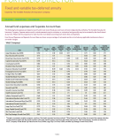
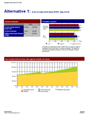
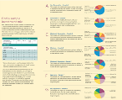
Multi-channel approach
Online
Over the Phone
Mobile
Print
In-Person
    Planning tools and calculators
    Videos and webcasts
    Financial plans
    Online aggregator
Retirement Education Center
Contact Center
    Transactions
    Online aggregator
    Planning tools and calculators
    Quarterly statements
    Enrollment materials
    Financial 360º
    Local financial advisors
    Face-to-Face
    Transition counseling
    Enrollment meetings
5
Notes:
Every workplace has a mix of employees with personal preferences who want and demand flexible participant services.
[CLICK]
On their retirement journey with VALIC, your employees can decide how much help they want and will be provided a variety of ways—online, by phone with mobile devices, printed materials or in person—to manage their retirement savings.

Slide 7


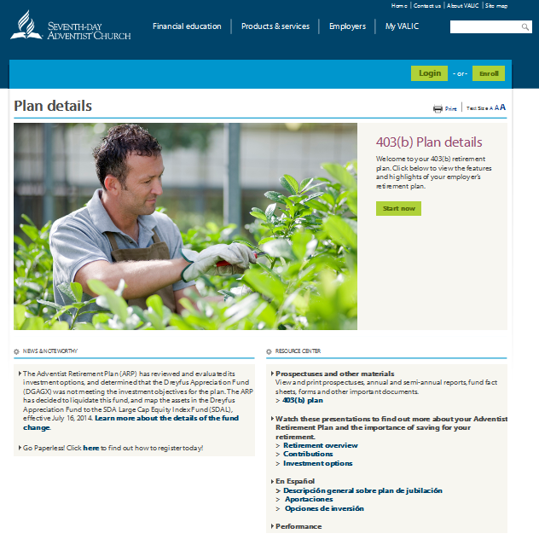

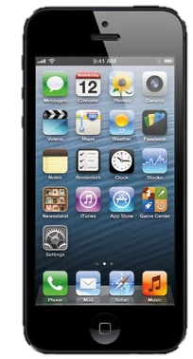
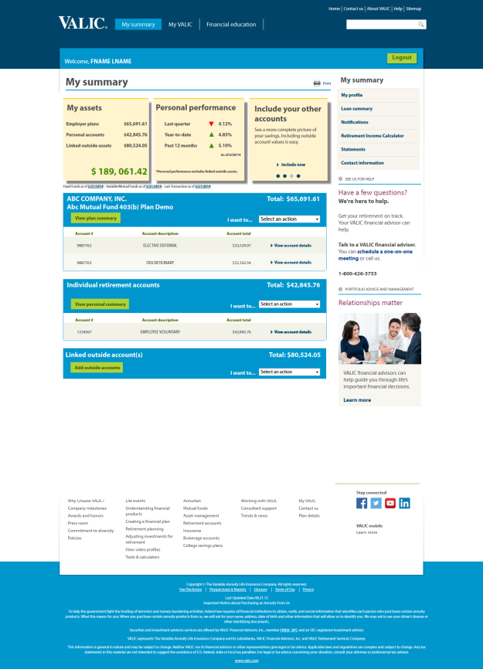



Easy access to resources
6
Notes:
6
We embrace adaptive technology to streamline your online plan management and provide your employees with efficient tools to help them track and manage their retirement plan accounts. Award-winning VALIC apps for mobile devices mean that your employees will find the information they want quickly and easily. Additionally, we make educational content and the latest industry news available across social media platforms such as Facebook, Twitter and YouTube.
-Web Demo-
User ID: VALICDEMO_3
Password: valic4demo
-iPad Video-
Click Dalbar seal (Youtube)
Click iPad (Video)

Slide 8

Retirement accounts are intended to be long-term investments. Income taxes are payable upon withdrawal. Federal restrictions and a 10% federal early withdrawal penalty can apply to withdrawals prior to age 59 1/2.
Neither VALIC nor its financial advisors or other representatives give legal or tax advice. Applicable laws and regulations are complex and subject to change. Any tax statements in this material are not intended to suggest the avoidance of U.S. federal, state or local tax penalties. For legal or tax advice concerning your situation, consult your attorney or professional tax advisor.
To view or print a prospectus, visit www.valic.com and click on ePrintSM under Links to Login. Enter your Group ID in the Login field and click go. Click on "Funds" in Quick Links, and funds available for your plan are displayed. The prospectus contains the investment objectives, risks, charges, expenses and
other information about the respective investment companies that you should consider carefully before investing. Please read the prospectus carefully before investing or sending money. You can also request a copy by calling 1-800-448-2542.
Securities and investment advisory services offered through VALIC Financial Advisors, Inc., member FINRA, SIPC and an SEC-registered investment advisor.
Annuities issued by The Variable Annuity Life Insurance Company. Variable annuities distributed by its affiliate, AIG Capital Services, Inc., member FINRA.
VALIC represents The Variable Annuity Life Insurance Company and its subsidiaries, VALIC Financial Advisors, Inc. and VALIC Retirement Services Company.
VALIC.com
Copyright © The Variable Annuity Life Insurance Company. All rights reserved.
VC 26369 (10/2015) J94262 ER

